Slide 1
Optical Character Recognition
Orville Anderson
University of Minnesota Morris, Senior Seminar, Fall 2025

Slide 2
Background
What is OCR?
Measuring Accuracy
Case Study
Introduction
Traits
Conclusion
Case Study Importance
Larger Picture
Stages of OCR
Results
Notes:
This presentation is split into three sections: background, a case study, and a bit of discussion
The background includes some definitions and information on methods
The case study is the bulk of this presentation. In short, some guy put together a whole bunch of documents to see what OCR model worked best for him
The conclusion goes over the importance of this specific case study, then talks about the larger impact

Slide 3
What Is OCR?
Defined as: the process of extracting text from images
This is useful when digitizing scanned documents (cough, cough, digital accessibility)
An “OCR model” is software which performs this process

Slide 4
OCR Stages
Image
(Scanned Doc)
Document Layout Analysis
Text Line Detection
Classification / Recogniton
Editable Text
Input
Output
Notes:
DLA includes some idea of text order
TLD uses pre-determined box sizes to isolate characters. There is generally some adjustments of the character, like rotating or centering it, to make the characters more uniform.
Classification of the un-identified character is where most of this process is, and I will talk about it on the next slide
The final part of this process is to repeat the classification step on every character found on the document, then to recombine the sections of text into one text file.

Slide 5
Classification Method – Matrix Matching
Output is some confidence / similarity metric
Notes:
Neural Networks have the advantage of a bit more flexibility in what it considers it’s collection of “known characters”.
Define Training

Slide 6
Classification Method – Neural Network
Output is some confidence / similarity metric
Notes:
Neural Networks have the advantage of a bit more flexibility in what it considers it’s collection of “known characters”.
Define Training

Slide 7
Disclaimers
I explain these training methods at this point, to say that OCR implementations are limited in some capacity to a concept of “known characters”.
The case study I talk about today is a collection of documents put together to evaluate accuracy, but the collection can then be used to train models.

Slide 8
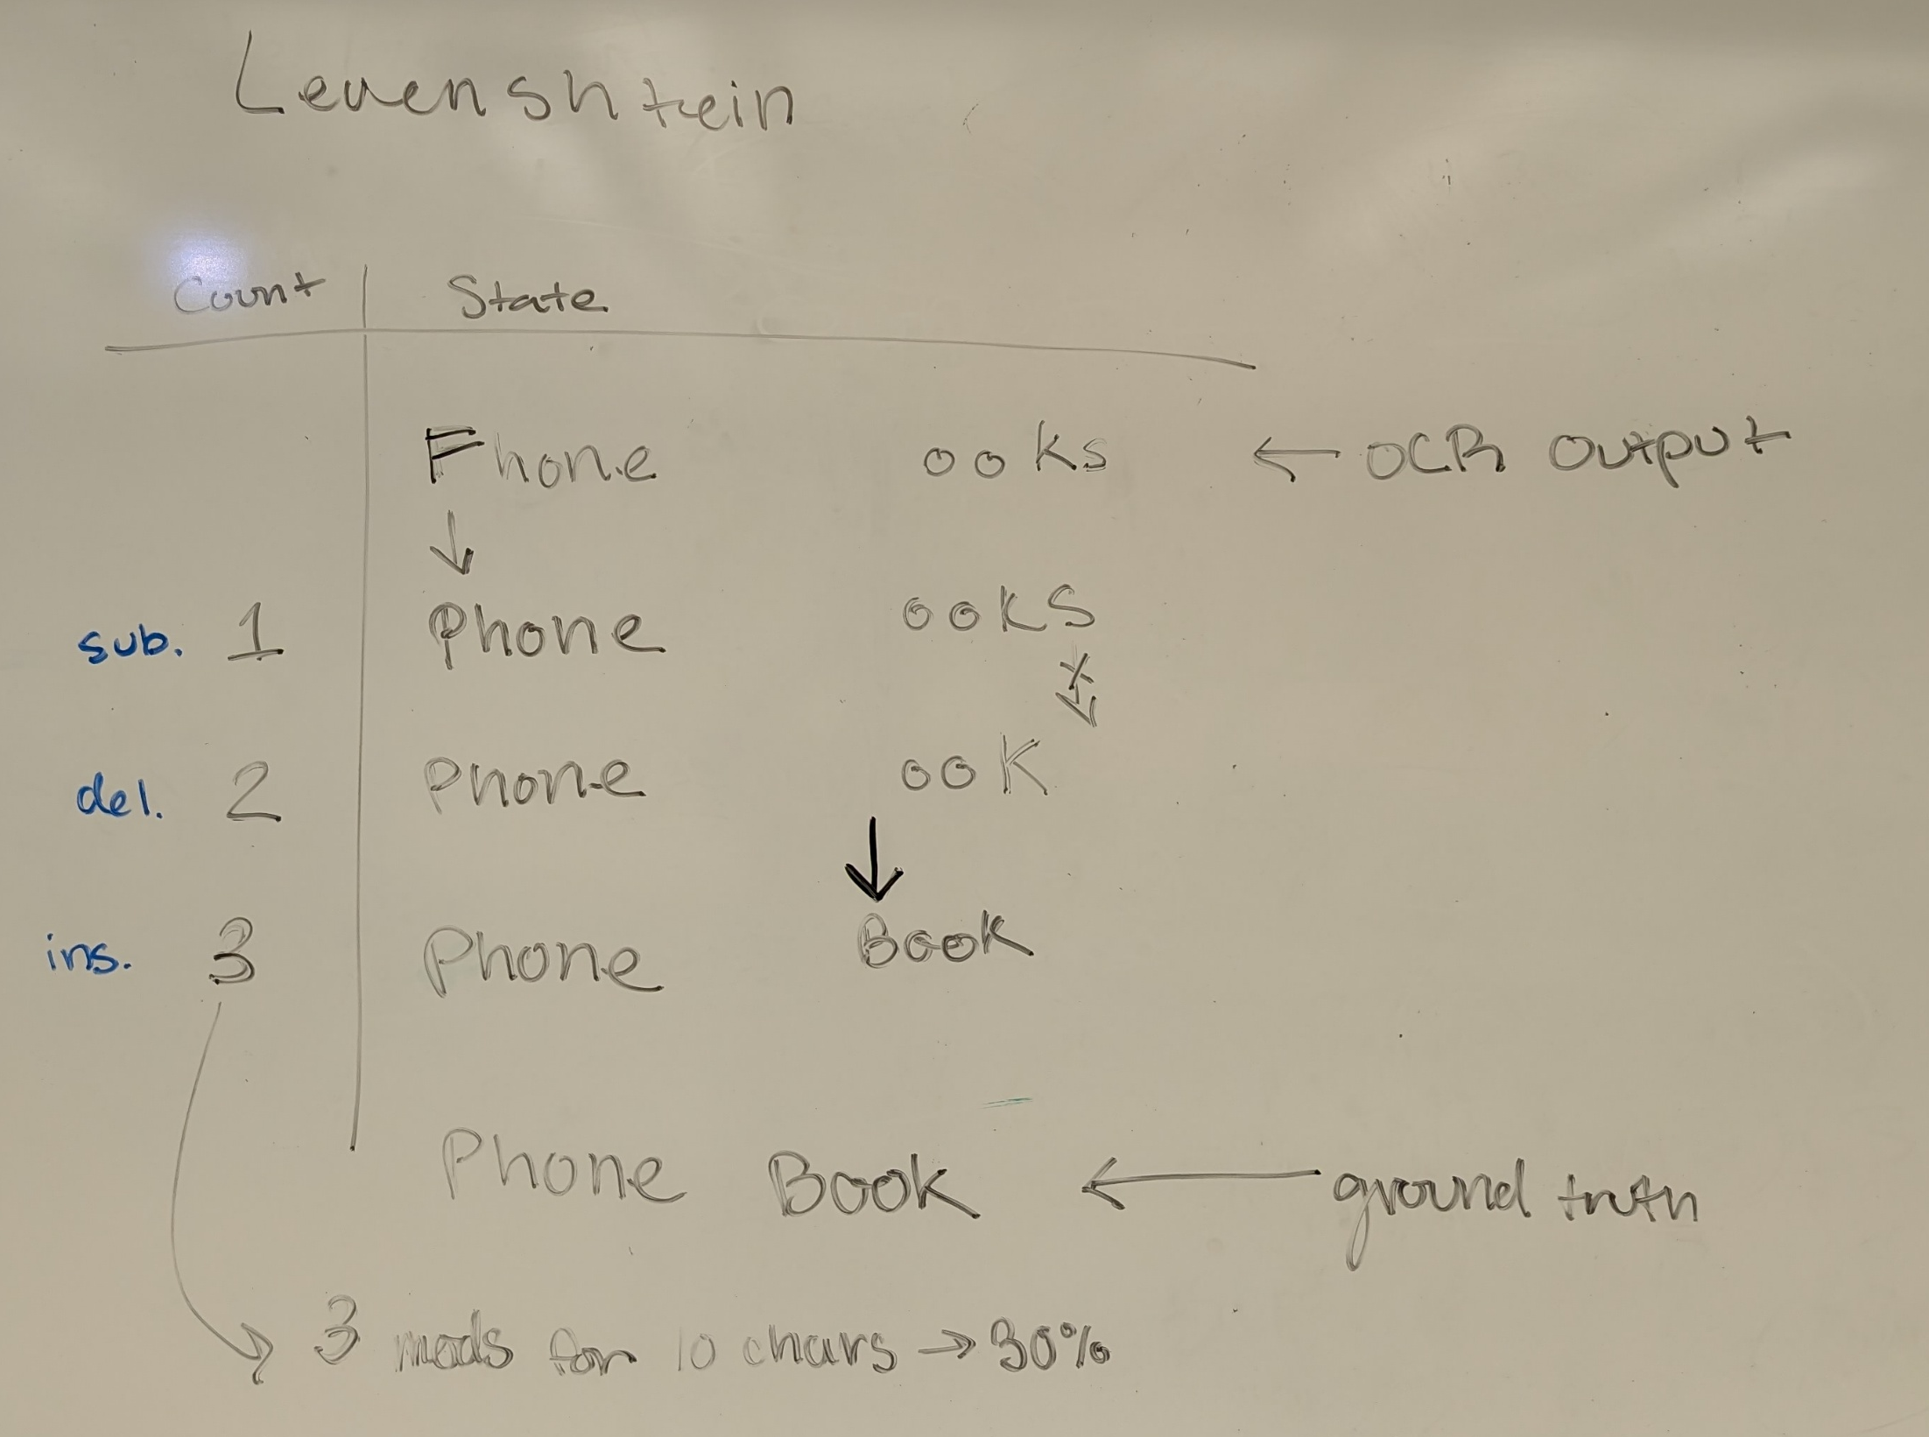
Accuracy
Terminology
Method
Need OCR output and knowledge of what was on the scanned document (ground truth)
Compare the two text files
Judge accuracy by individual words and characters
Case Study uses Levenstein(?) Distance
Notes:
There are many ways to compare OCR implementations, such as if you need to pay to use them and what languages they can be used on.
The case study we are about to talk about is primarily comparing three implementation based on character accuracy. He measures accuracy as the number of insertions, deletions and substitutions needed to make the OCR output match the ground truth. The number of modifications is then divided by the number of characters from the document, to make it a percentage.

Slide 9
Case Study
Source Documents
Old Books
Apply Noise
Identified in later slide
Apply OCR
Used Amazon, Google, and one open-source
Arabic Wiki
Thomas Hegghammer, 2021
Primarily a Historian (working with Arabic texts)
Wanted to find the best OCR technology publicly available to digitize historical documents
Put together a large collection of English and Arabic documents with a variety of layouts and with artificial noise
Collection is called Noisy OCR Dataset (NOD)

Slide 10
Layout
[1 column example from dataset] [2 column] [2 column with picture] [example with a table?]

Slide 11
Layout
Image
(Scanned Doc)
Document Layout Analysis
Text Line Detection
Classification / Recogniton
Editable Text
Put individual characters back in order
Marked order of text regions
Notes:
Remember the stages of OCR? Remember how in DLA we needed to mark the order of text regions? Remember how when we combined the individual characters to make the editable text they needed to be put back in order?
Some awareness is needed to use OCR on documents that are not just one single text column.

Slide 12
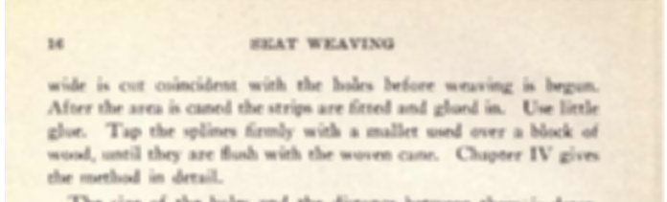
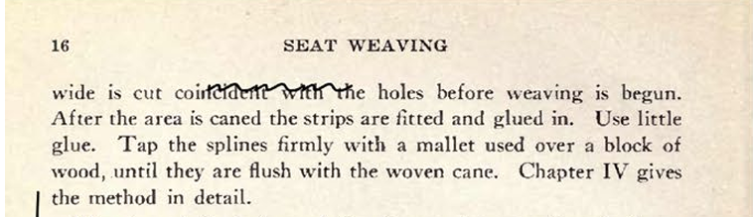
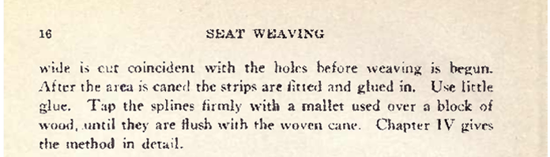
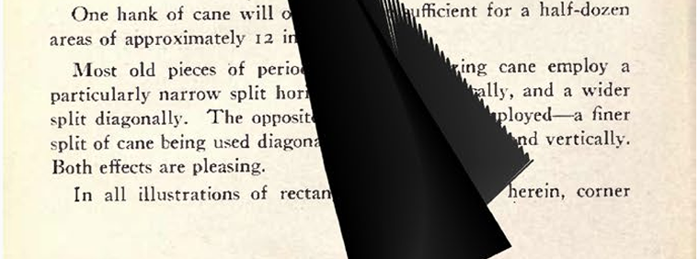
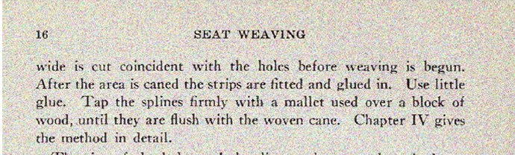
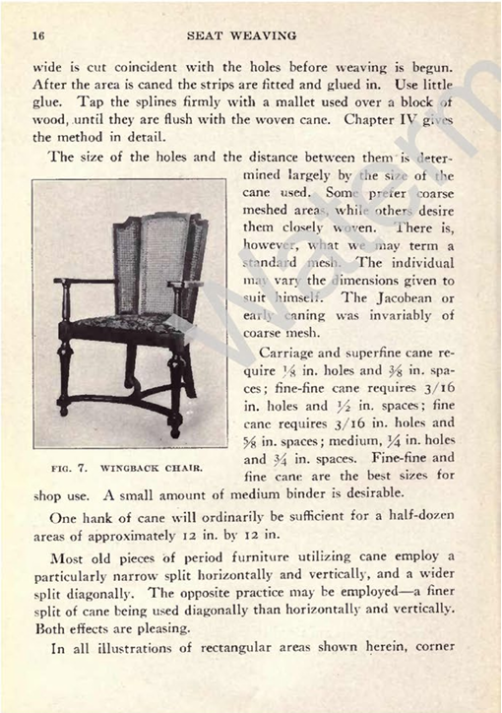
Noise
Blur
Scribbles
Picked because they are the most common noise found in historical documents
Splits into two categories:
Mistaken for text
Obscures text
Weak Ink
Ink Stain
Salt and Pepper
Watermark

Slide 13
Noise
Mistaken for text
Obscured Text
Some models include a pre or post-processing step
Blocking letters goes back to layout struggles

Slide 14

Writing Systems
Most OCR are made to recognize Latin based written languages: English, Spanish, German, etc.
This covers most documents (Latin is the most widely used writing system)
As mentioned earlier, OCR tech is limited to characters it has been exposed to previously.
Arabic, the third most widely used writing system is very different from Latin.
Diacritics
Cursive or connected characters

Slide 15
Why is Writing System a Challenge
The Text Line Detection stage uses boxes of pre-set sizes. Cursive Characters need larger boxes
Noise Prevention techniques can remove diacritics
Notes:
Remember my comment about the TLD stage using predetermined box sizes? Some studies found that cursive characters need larger boxes
Remember noise prevention techniques? What do you think those do to diacritics?

Slide 16
Results – Layout, Writing Systems, and Models
Some OCR models cost money
Some were easier to use
Some had limited support for languages
Model | Paid? | User Interface? | Arabic?
Google Document AI | Yes # | Yes | Yes
Amazon Textract | Yes # | Yes | No
Tesseract | No | No | Yes
Notes:
As mentioned earlier Hegghammer is an academic working with a large amount of documents. He spends a bit of time talking about price,
Need to actually talk about accuracy differences in writing systems, maybe also mention his lack of discussion on layout’s impact.
Fun fact, like all of these have changed

Slide 17
Results – Noise
Hegghammer layered levels of noise, as suspected, more layers reduced accuracy
He split each source document into a b/w version and a color version, then applied every combination of noise types (for a total of 44 documents per source document)
Some noise types had a larger impact (integrated noise) (include images)
Notes:
The horrible, evil, tables

Slide 18
Case Study Importance
Draws attention to types of noise that have larger impact on OCR
Provides commentary for other academics
Documents and findings of the study are publicly available
Noise generator is publicly available

Slide 19
Larger Picture
This study was born out of a real case, where a real person cared about the accuracy
For a general content analysis, an accuracy of 99.9% is workable, but for large amounts of documents and an application which requires truthful representation of the text, every character matters.
If we treat these document features as extremes, the techniques can still be applied in current cases (handwriting OCR)
Studies like this help guide innovation

